Slide 1
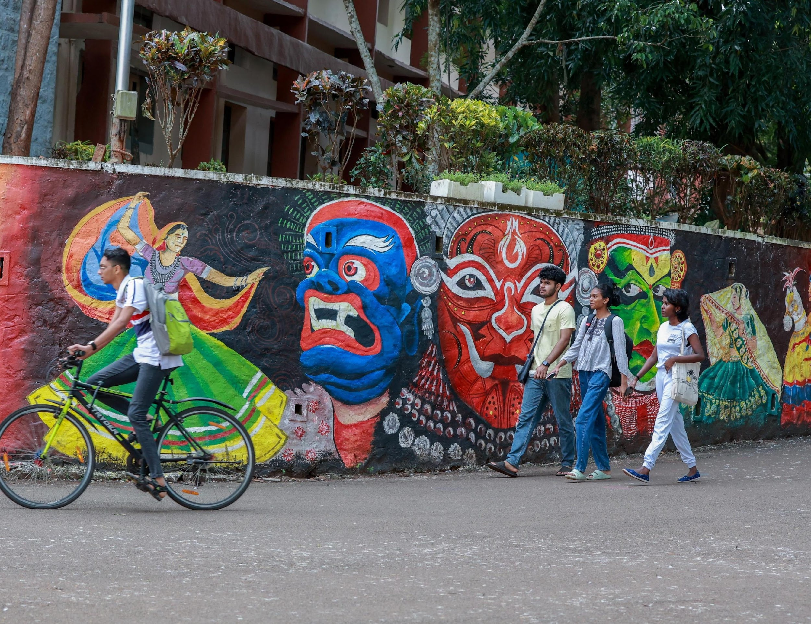
NATIONAL INSTITUTE OF TECHNOLOGY CALICUT | INDIA

Slide 2
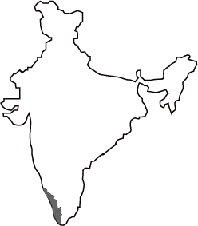
CALICUT, KERALA, INDIA
CALICUT (KERALA)
ABOUT CALICUT
Calicut, also known as Kozhikode, located in the Malabar region of Kerala State, found a place in world history with the discovery of a sea route to India in 1498 by the Portuguese navigator Vasco da Gama.
KERALA (INDIA)
Calicut was given the tag of City of Sculptures (Shilpa Nagaram) in 2012 because of the architectural sculptures around the city. Besides, Calicut declared India’s first UNESCO City of Literature in 2023.
Basking in the idyllic setting of the Arabian Sea on the west and the proud peaks of the Wayanad hills on the east, Calicut is known for its serene beaches, lush green countryside, historic sites, calm backwaters, wildlife sanctuaries, rivers and waterfalls.
Calicut - the city of truth, has a population of 1.8 million and is home to premier educational/research institutions. Currently there are many IT companies running in Cyberpark and HiLITE Business Park.

Slide 3
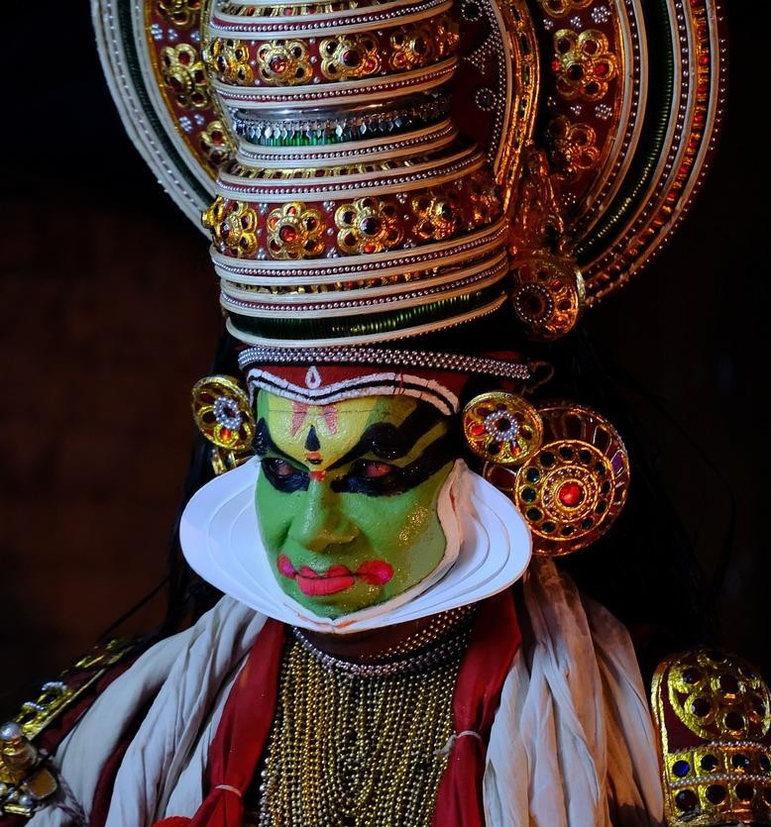
The region of Malabar that hosts the Institute is the northern part of the State of Kerala and is a destination for ecotourism.
Malabar is historically known for its spices and trading with the Middle East.
Kerala is a popular tourist destination, known for its serene backwaters, wildlife sanctuaries, hill stations, and historic sites. Nature's bounty, vibrant culture and exotic cuisine bespeak the land's tourist slogan "God's Own Country".
The state is known for its classical dance forms like Kathakali and Mohiniyattam, as well as traditional music and art forms. The official language of Kerala is Malayalam.
NIT CALICUT | nitc.ac.in

Slide 4
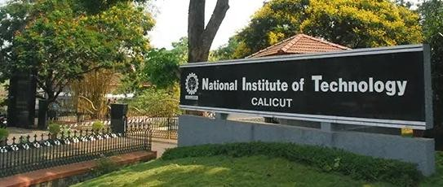
ABOUT NIT CALICUT
VISION
International standing of the highest calibre.
MISSION
To develop high-quality technical education and personnel with a sound footing on basic engineering principles, technical and managerial skills, innovative research capabilities, and exemplary professional conduct to lead and to use technology for the progress of mankind, adapting themselves to changing technological environment with the highest ethical values as the inner strength.
National Institute of Technology Calicut (NITC)
is one of the 31 institutions of national importance set up by an Act of Parliament namely the ‘NITSER Act 2007’, and is fully funded by the Government of India.
Originally established in 1961 as a Regional Engineering College (REC), it was transformed into a National Institute of Technology in 2002.
NIT CALICUT | nitc.ac.in

Slide 5
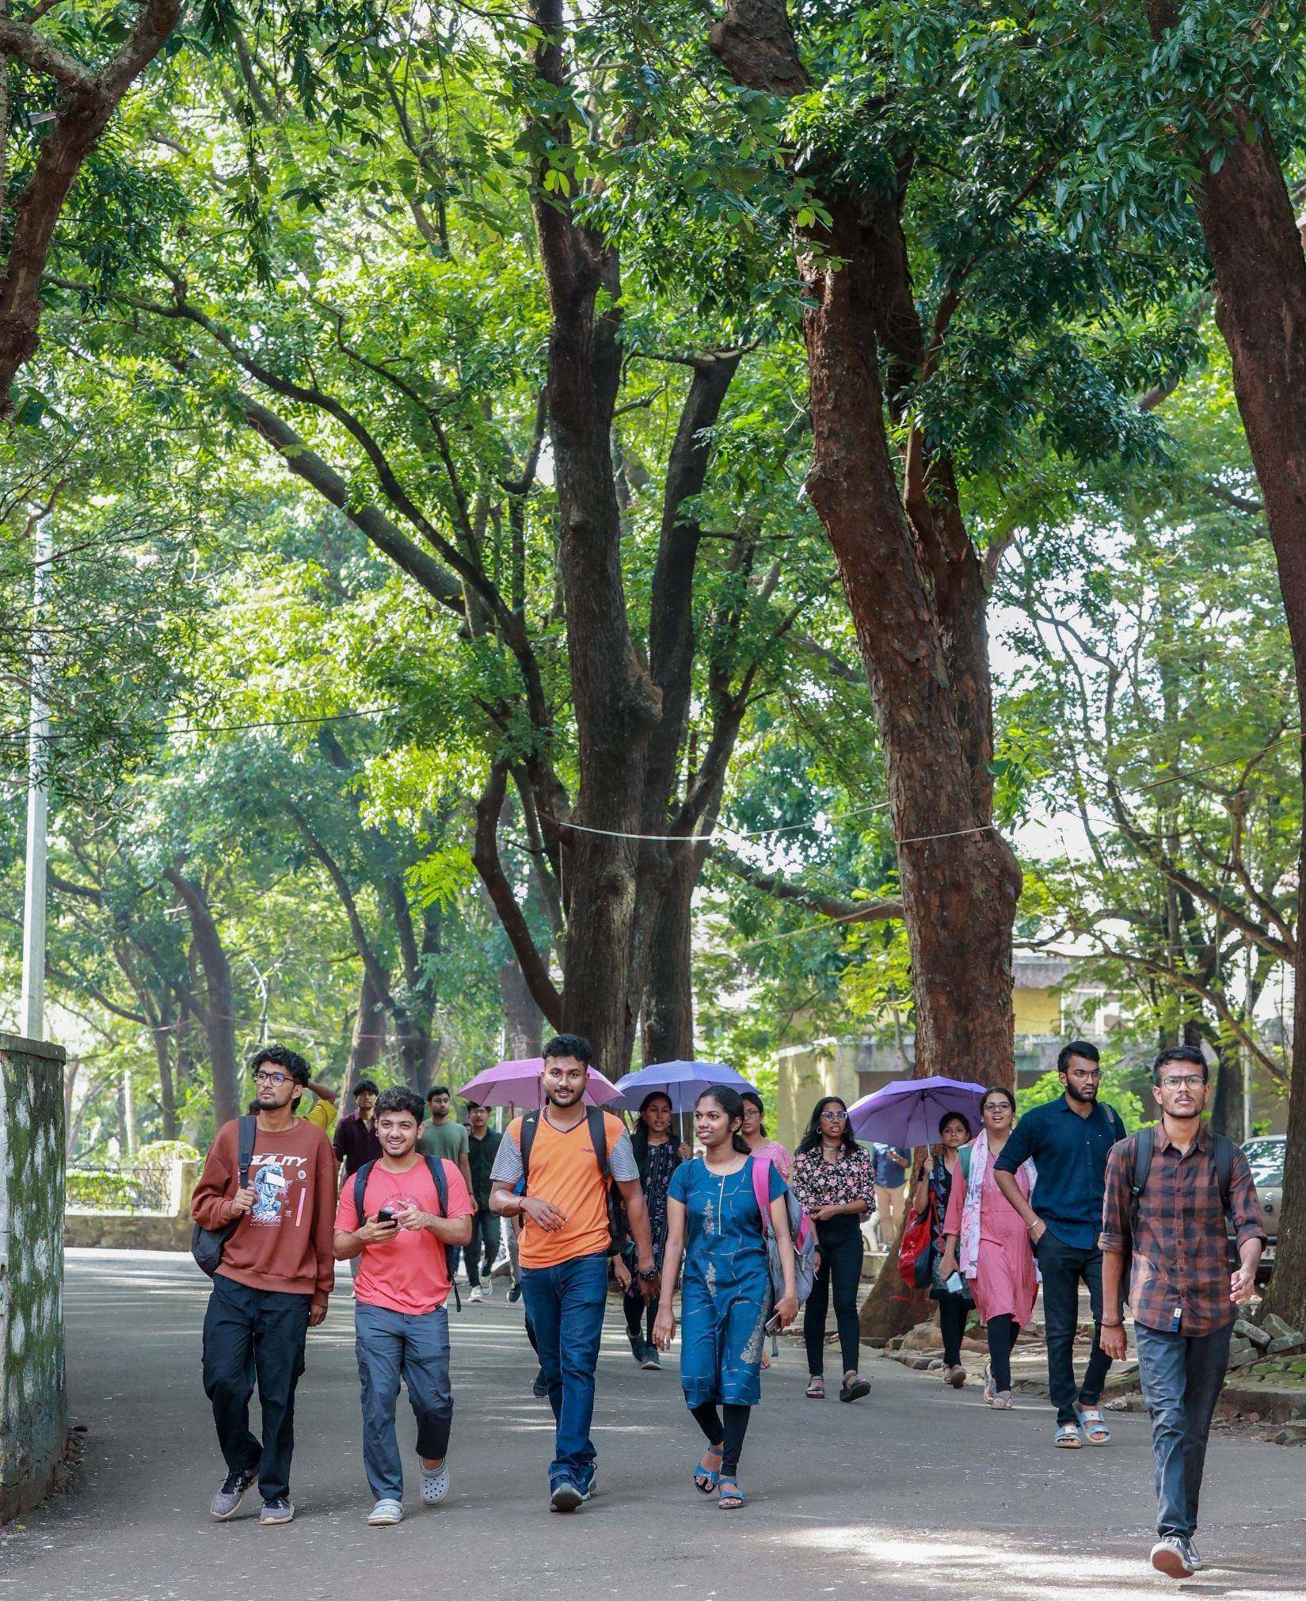
A GLANCE AT NIT CALICUT
With its proactive collaborations with a multitude of research organizations, academic institutions and industries, the institute has set a new style for its functioning under the NIT regime.
Being a fully residential institution, the campus houses:
Academic buildings
Research labs
Hostels
Residences and other amenities among its infrastructure.
Doctoral-level research has remarkably increased in recent times, with a substantial increase in the volume of research papers and patents produced.

Slide 6
INSTITUTE OVERVIEW
The Institute offers Bachelor’s, Master’s and Doctoral Degree programs in programs in
Engineering | Science | Technology | Management
15 33
Departments
12
UG Programmes
PG Programmes including an MBA
PhD Programme in all Departments
Regular Teaching Faculty
422
Regular Non- Teaching Faculty
289
8000+
UG,PG & PhD Students on Roll 31% Students are Girls
45000+
Distinguished Alumni

Slide 7
ACHIEVEMENTS & RECOGNITIONS: LAST THREE YEARS
NIRF India Ranking 2024
25 3
NIRF India Ranking 2023
23 2
NIRF India Ranking 2022
31 2
ENGINEERING ARCHITECTURE
ENGINEERING
ARCHITECTURE ENGINEERING ^{ARCHITECTURE}
Atal National Ranking of Institutions on Innovation Achievements (ARIIA) -2023:
NIRF Innovation Ranking 2023
Institute’s Innovation Council (IIC) – 2023
8
4
9
(The only NIT among the top 10)
Four Star Rating
(The only NIT among the top 10)

Slide 8
DEPARTMENTS AND CENTRES
DEPARTMENTS
CENTRES
Architecture and Planning
Bioscience and Engineering
Chemical Engineering
Chemistry
Civil Engineering
Computer Science & Engineering
Department of Education
Electrical Engineering
Electronics & Communication Engineering
Humanities, Arts and Social Sciences
Materials Science and Engineering
Mathematics
Management Studies
Mechanical Engineering
Physics
CENTRES
Centre for Career Development
Centre for Continuing Education and Skill Development
Centre for Culture and Art Relations (CCAR)
Centre for Holistic Teaching and Learning
Centre for Indian Knowledge Systems
Centre for Industry – Institute Relations (CIIR)
Centre for Innovation, Entrepreneurship & Incubation
Centre for Public Relations, Information and Media Exchange (C-PRIME)
Centre for Quality Assurance and Enhancement
Centre for Yoga and Holistic Wellness
Centre for Women Welfare and Social Empowerment
Centre for Student Activities and Sports
Centre for Climate Resilience and Disaster Management
Centre for Blue Economy and Coastal Resilience
Centre of Excellence in Artificial Intelligence
Centre for Space Science and Technology
Advanced Manufacturing Centre
Centre for Information Technology, Research, and Automation (CITRA)
Centre for Computational Modelling and Simulation (CCMS)
Centre for Materials Characterization (CMC)
Centre of Excellence in AI for Sustainable Cities
Centre for Transportation Research
Centre for River Basin Management
Centre for Clean Energy and Circular Economy
Centre for Sustainable Technologies
Centre for Electric Vehicle Engineering
Centre of Excellence in Logistics and Supply Chain Management

Slide 9
ACADEMIC PROGRAMS
 | Departments | B.Arch/B. Tech/BSc.Ed | M.Tech/M.Plan | MSc/MA/MBA | Ph.D.
 | Architecture and Planning (5 years) | ✔ | ✔ | × | ✔
 | Bioscience and Engineering | ✔ | ✔ | × | ✔
 | Chemical Engineering | ✔ | ✔ | × | ✔
 | Chemistry | × | × | ✔ | ✔
 | Civil Engineering | ✔ | ✔ | × | ✔
 | Computer Science and Engineering | ✔ | ✔ | × | ✔
 | Department of Education | ✔ | × | × | ×
 | Electrical Engineering | ✔ | ✔ | × | ✔
 | Electronics and Communication Engineering | ✔ | ✔ | × | ✔
 | Humanities, Arts and Social Sciences | × | × | × | ✔
 | Materials Science and Engineering | ✔ | ✔ | × | ✔
 | Mathematics | × | × | ✔ | ✔
 | Mechanical Engineering | ✔ | ✔ | × | ✔
 | Management Studies | × | × | ✔ | ✔
 | Physics | ✔ | × | ✔ | ✔
NIT CALICUT |
nitc.ac.in

Slide 10
INTERDISCIPLINARY RESEARCH
PROGRAMMES/AREAS/THRUST AREAS OF RESEARCH
The major areas of research and consultancy of various departments/schools are as follows:
Architecture & Planning
Mathematics
Chemical Engineering
Mechanical Engineering
Chemistry
Physics
Civil Engineering
Computer Science & Engineering
Department Of Bioscience & Engineering
Department Of Management Studies
Electrical Engineering
Electronics & Communication Engineering
Department Humanities, Arts & Social Sciences
Department Of Materials Science & Engineering
NIT CALICUT |

Slide 11
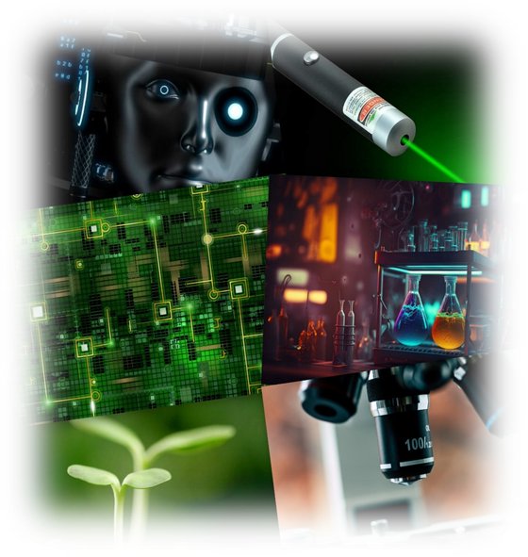
RESEARCH THRUST AREAS
5G and Next Generation Communication Technologies
Semiconductor Research
Cyber Security
Artificial Intelligence
Additive Manufacturing
Climate Resilience and Disaster Management
Blue Economy
Deep Sea Research and Coastal Resilience
Robotics
Genetic Engineering
Energy and Electrochemical Engineering Bioengineering
Digital Healthcare
Nanotechnology
Waste Management
Natural hazards
Town Planning
Electric Vehicle Engineering
Technology Management
Genetic Engineering

Slide 12
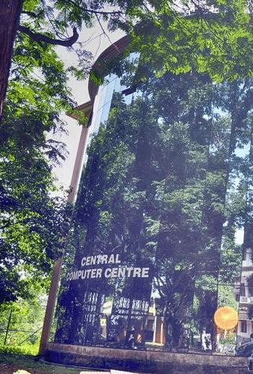
THEMATIC CENTRES
Centre for Computational Modeling and Simulation (CCMS)
CCMS aims to promote and support computational modelling as a mainstream research activity amongst the faculty and researchers of NIT Calicut.
Link: https://nitc.ac.in/thematic-centres/centre-for-computational-modelling-and-simulation-ccms
Centre for Materials Characterization (CMC)
The Centre for Materials Characterization (CMC) to host highly sophisticated testing, characterization and analysing facility to boost up the cutting edge research in Materials Engineering, Chemistry, Nanotechnology and allied areas.
Link: https://nitc.ac.in/thematic-centres/centre-for-materials-characterization-cmc
Centre Computer Centre (CCC)
CCC is the central facility in NIT Calicut which caters for the computing requirements of the whole community of this institution. The Centre has state of the art infrastructure with four fully operational terminals spanning over three floors of the building..
Link: https://nitc.ac.in/thematic-centres/central-computer-centre-ccc

Slide 13
CENTRES OF EXCELLENCE (RESEARCH CENTRES)
Design Innovation Centre
Design Innovation Centre ( DIC) was established by an MoU signed between NIT Calicut and IISc, Bangalore on 06-05-2015. The objectives of this centre are to promote a culture of innovation and creative problem solving, to promote knowledge sharing and to enhance interdisciplinary design-focused education, research and entrepreneurial activities.

Slide 14
RESEARCH & CONSULTANCY
NIT Calicut encourages research and innovation, with faculty and students actively engaging in projects.
The institute has secured substantial funding from esteemed governmental and industrial agencies, with nine departments receiving FIST funding.
The testing and consultancy services have expanded recently, and the department of civil engineering offers exceptional consultancy and testing services in multiple fields.
NITC collaborates with foreign universities and institutions, enriching the research and development environment and enhancing the global research network.
https://randc.nitc.ac.in/

Slide 15
SPONSORED RESEARCH PROJECTS
SPONSORED RESEARCH PROJECTS (SANCTIONED AMOUNT)
2022-23
9.3
44
2021-22
13.92
45
2020-21
10.36
32
2019-20
5.11
26
2018-19
9.8
25
0 5 10 15 20 25 30 35 40 45 50
Overlay amount in Rupees (Crores) No. of projects

Slide 16
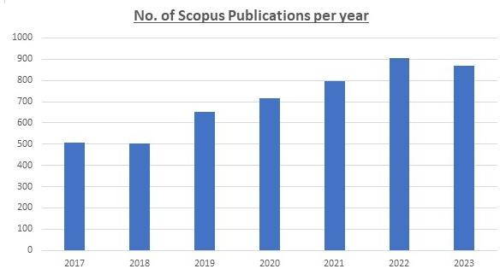
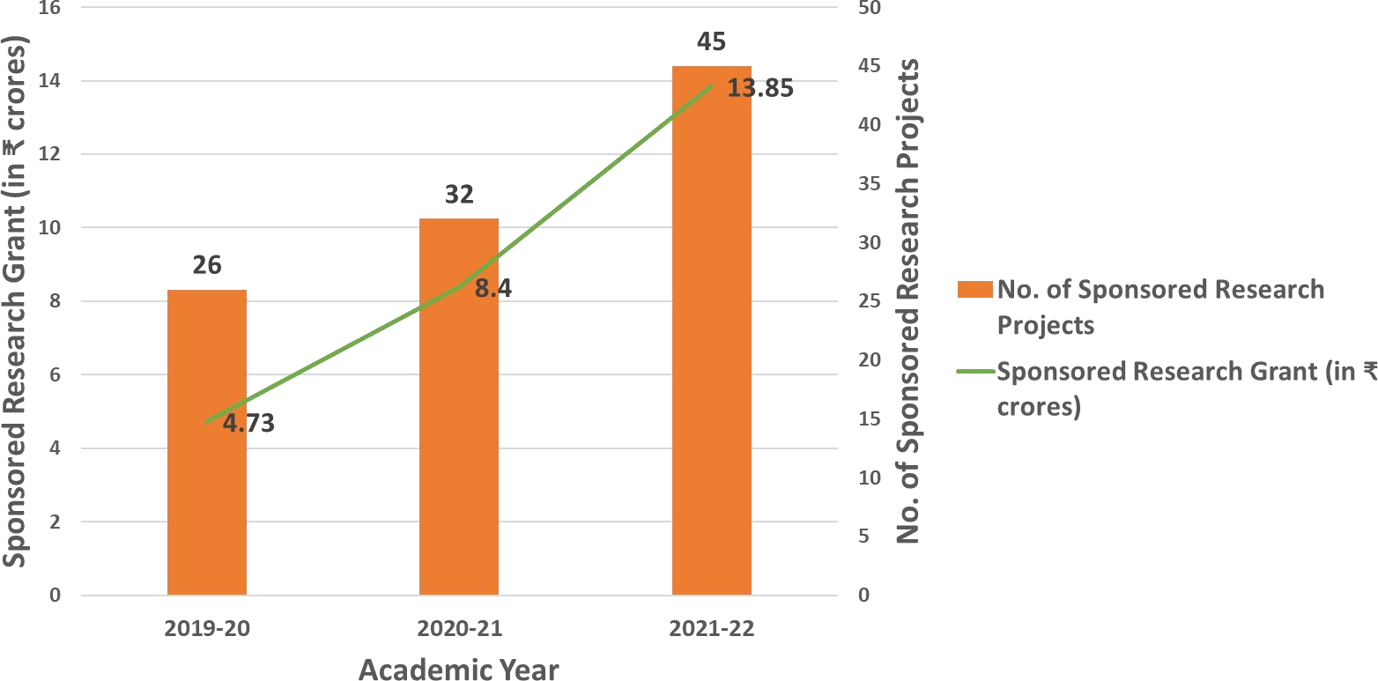
RESEARCH & CONSULTANCY

Slide 17
INNOVATION AT NITC
Entrepreneurship Ecosystem
NIT Calicut has a thriving entrepreneurship ecosystem, with a dedicated incubation centre to support students' start-up ideas. This promotes innovation and entrepreneurship among students.

Slide 18
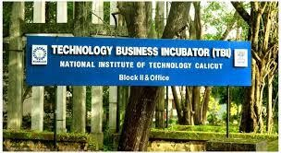
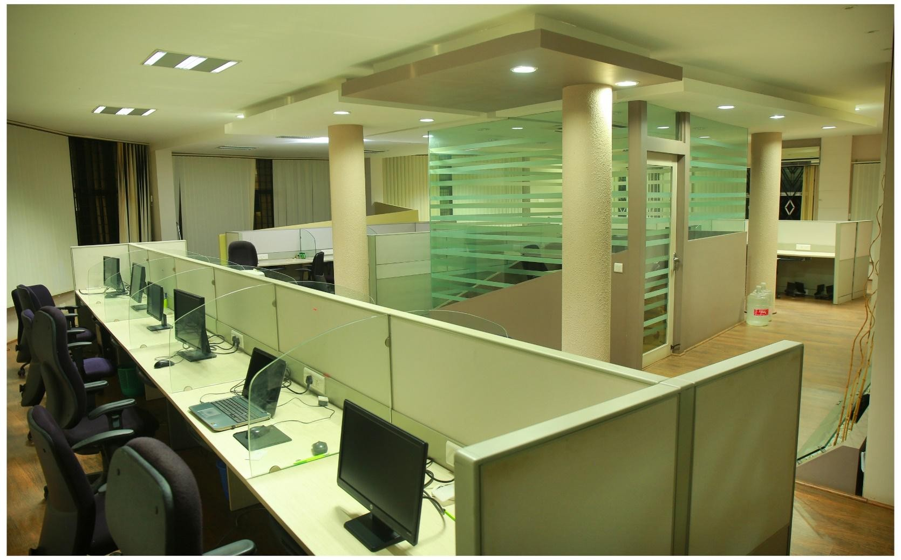
TECHNOLOGY BUSINESS INCUBATOR (TBI)
Institute set up the TBI in 2004 with the support of the National Science and Technology Entrepreneurship Development Board (NSTEDB) of the Department of Science and Technology to incubate start-up industries.
A dedicated Fab Lab facility is set up for the use of innovators.
TBI also provides financial assistance to companies which require funds for their operations.
TBI support the innovators for prototype development through the NIDHI-PRAYAS scheme giving grants up to Rupees 10 lakhs.
Conducted 70+ training programmes in entrepreneurship development and trained approx. 1400 entrepreneurs.

Slide 19
TECHNOLOGY BUSINESS INCUBATOR (TBI)
Sector agnostic - Open to innovators from all sectors
Services offered to startups – Technical, Mentoring, marketing, Funding, Statutory and legal assistances
Departments/Ministries associated with – DST, Technology Development Board, MeitY (TIDE Scheme), MoMSME (Incubator, Design scheme, AESDP), Defence Innovation Organisation (iDex), Kerala Startup Mission (IEDC), KDISC (ODOI, YIP)
Project done that has social impact – Coir Cluster development at Balussery (MoMSME)
115
92
71
12
1200
COMPANIES INCUBATED
GRADUATED COMPANIES
FUNDED COMPANIES
COMPANIES HAVING MORE THAN 1CR
EMPLOYMENT GENERATION

Slide 20
STUDENT ACTIVITIES
Team Unwired
Robotics club
IEEE Student Chapter
ISTE Student Chapter
Technical and Cultural Festivals: NIT Calicut is known for its annual technical and cultural festivals, such as 'Tathva' and 'Ragam.' These events attract participants and enthusiasts from all over the country, making them a hub for creativity and innovation. RAGAM and TATHVA organized by the Students Affairs Council (SAC)
NASA ( Architecture)
Aero Modelling Club
Dept. Associations
Student magazine published annually to showcase the talents of students Several student clubs for activities like music, debate, dance, drama, management, entrepreneurship, literary affairs, animal welfare etc.
AI Club
Active SPICMACY Calicut chapter Film club arranges screening of movies in open air theatre National Service Scheme (NSS) for community services (4 Units) National Cadet Corps (NCC) : Naval Unit (1 unit) Inter scholastic- Home and Away- district championship, state championship, inter-university tournaments, inter NIT tournaments, etc.
Innovation Club- NOVA
Code Chef NITC Chapte
NIT CALICUT | nitc.ac.in

Slide 21
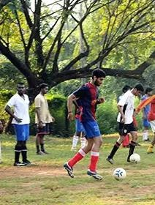
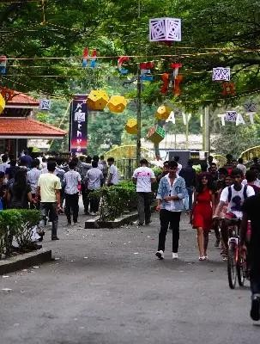
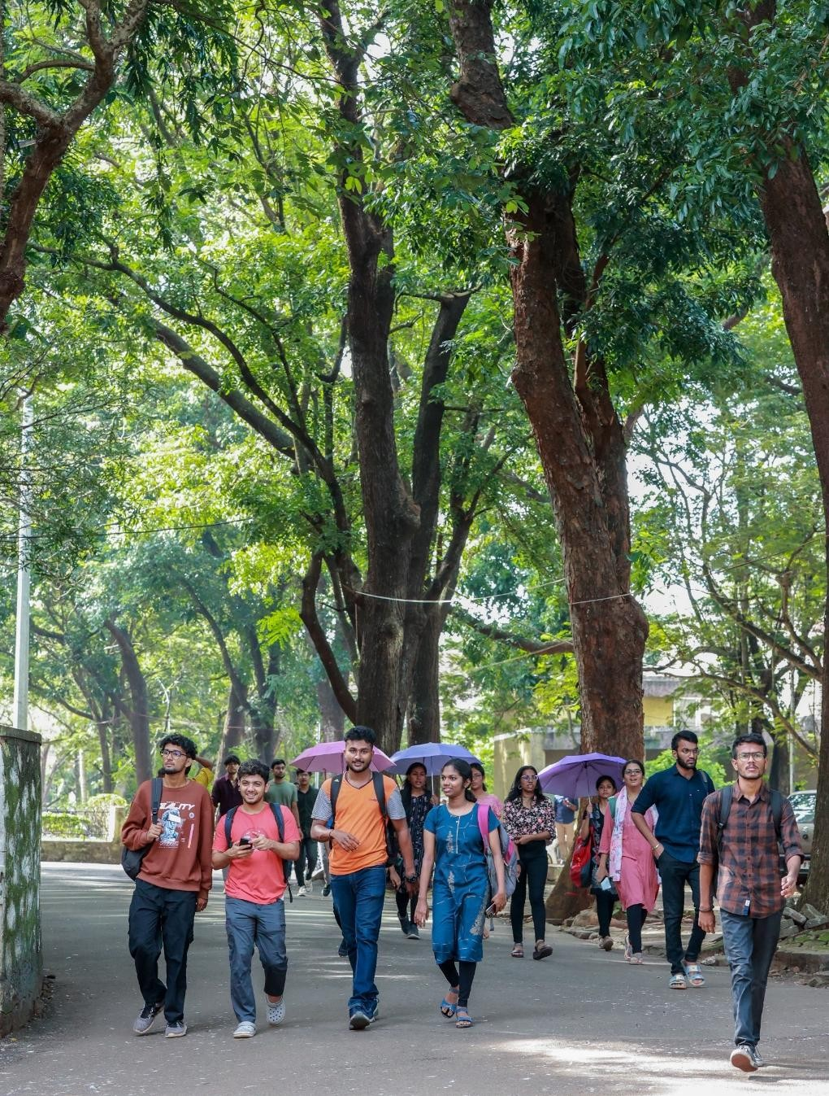
LIFE ON NITC CAMPUS

Slide 22
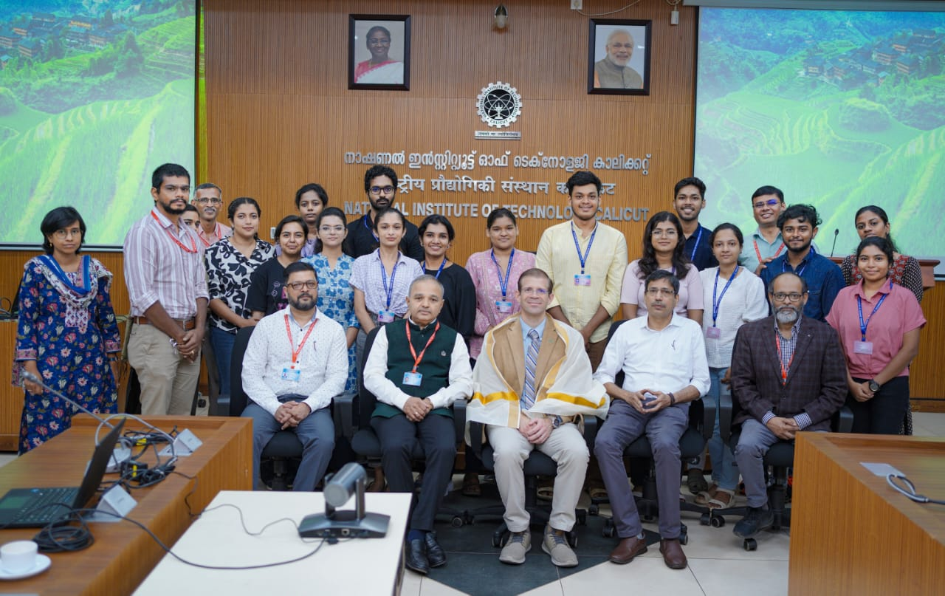
INTERNATIONAL, ALUMNI & CORPORATE RELATIONS (IACR) - International
Strengthen International collaboration in the Academic and Research domain
Establish a mechanism for the attainment of global standards among the NITC fraternity
Mobilise International Academic Collaboration
Focus on creating world-class teaching practices and curriculum
The office for International Relations aims to foster academic and research collaborations with reputed institutions and industries from India and abroad for the internationalization of higher education.
14 MoUs with reputed international institutes/Universities fostering scholarly exchanges.
Prof. Paul Kreuger visited and interacted with students selected for joined master’s program with UNT USA.

Slide 23
INTERNATIONAL, ALUMNI & CORPORATE RELATIONS (IACR) - International
The active academic programme with student mobility :
NIT Calicut established a Dual-Degree Masters program with the University of North Texas, USA for M.Tech. /MS in Bioengineering/Biomedical Engineering in 2024.
NIT Calicut established an agreement on an Accelerated MS Program in Physics and Applied Physics with Michigan Technological University, USA for B.Tech graduates.
NIT Calicut established an agreement on the Joint Doctoral Program (JDP) –Cotutelle Norwegian University of Science and Technology, Norway
Semester exchange /Internship students from various FHEI to NITC

Slide 24
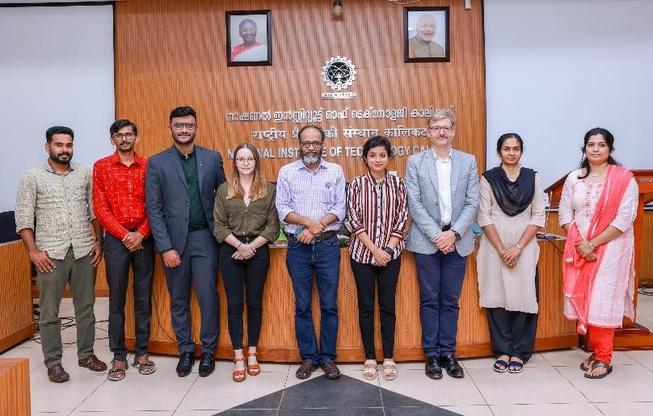
INTERNATIONAL, ALUMNI & CORPORATE RELATIONS (IACR)
Strengthen International collaboration in the Academic and Research domain
Establish a mechanism for the attainment of global standards among the NITC fraternity
Mobilise International Academic Collaboration
Focus on creating world-class teaching practices and curriculum
The office for International Relations aims to foster academic and research collaborations with reputed institutions and industries from India and abroad for the internationalization of higher education

Slide 25
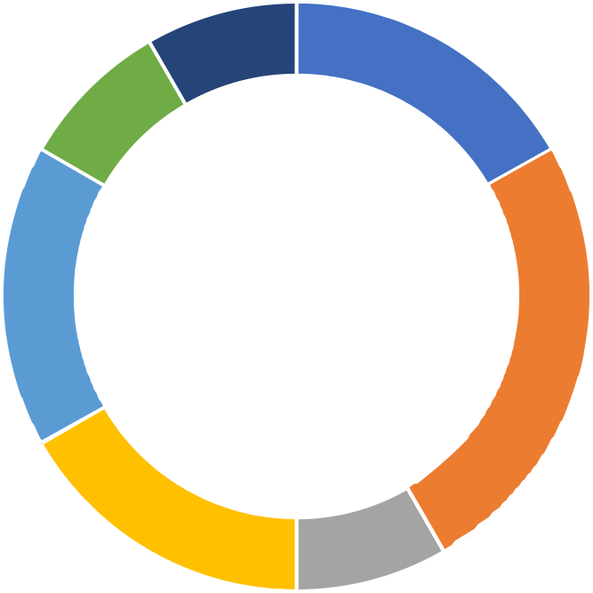
INTERNATIONAL RELATIONS
Number of International students in each year
Number of MoU with the NITC
5
5
3
3 3 3
3
2
2
1
1 1
1 1
2017
2018
2019
2020
NO.OF STUDENTS
2021
2022
2023
MOZAMBIQUE
American
Sri Lanka Nepal
Bangladesh Indian(UAE)
Australia Norway Japan
USA U K
Germany

Slide 26
INTERNATIONALISATION OF THE INSTITUTE
International Partners of NITC
International Students@ NITC
4
INTERNATIONAL STUDENTS
6
3
5
4
2
No. of MoU’s
3
No.of Students
1
2
1
0
0
Australia USA
Norway
U K
Japan Germany Belgium
2017
2018
2019 2020
2021
2022
2023
Year of Admission
Mozambique Sri Lanka Bangladesh America Nepal Indian(UAE)

Slide 27
INTERNATIONAL, ALUMNI & CORPORATE RELATIONS
NITC has a vibrant Alumni community of over 40,000 members. All of them are part of the NITC Alumni Association (NITCCAA)
₄₅₀₀₀
ALUMNI MEMBERS
The Institute Management System (IMS) and the new Institute website are two key Alumni-sponsored projects. Work is progressing on a student plaza named 97th Avenue, sponsored by the 1997 batch. The North America NITC Alumni Association is coordinating the NITC Alumni Mentoring Program (NITCAMP) to provide academic and career guidance to current students.
21
ALUMNI CHAPTERS
Eminent Alumni visit the campus regularly and interact with students as part of the Distinguished Alumni Lecture Series.
225 L+
ALUMNI CONTRIBUTION 3 YEARS
Alumni are also co-teaching various courses along with regular faculty. NITC has instituted a Distinguished Alumni Awards scheme to celebrate the professional achievements and contributions of its Alumni under seven categories.

Slide 28
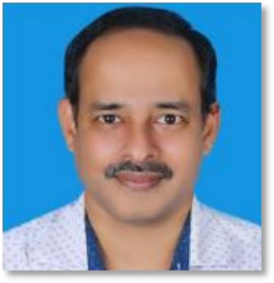
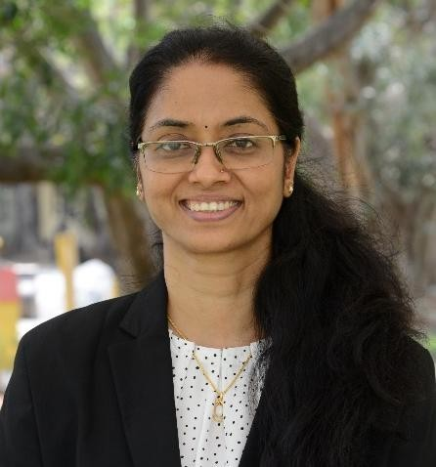
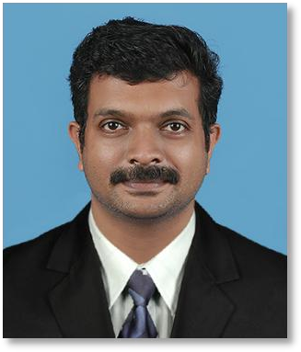
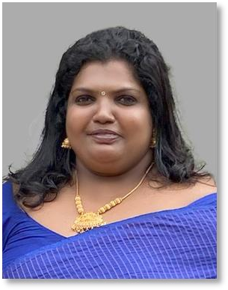
CONTACTS
Prof. M.K. Ravi Varma
Dean (International, Alumni, and Corporate Relations)
deaniacr@nitc.ac.in
(M) +91 95441 06752 (L) 0495-2286142
Ms. Kavitha G R
Advisor, International Relations
advisor.ir@nitc.ac.in
+91 9444536574
Dr. Maneesh Chandran
Associate Dean (International Relations)
ir@nitc.ac.in
(M) +91 94441 85850 (L) 0495-2286189
Ms. Ramya P Officer, Dean (IACR) iacroffice@nitc.ac.in
(M) +91 98958 47518 0495- 2285091

Slide 29
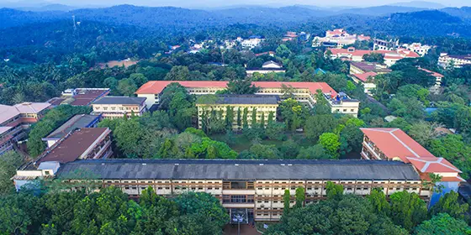
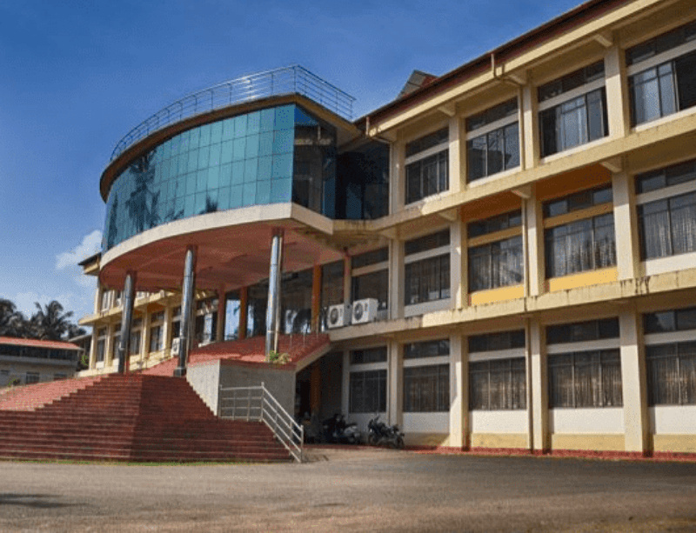
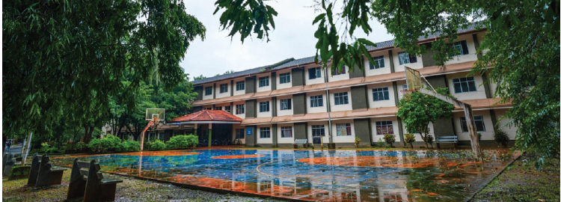
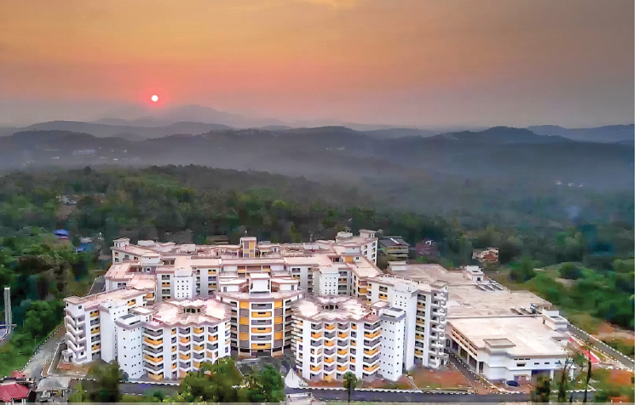
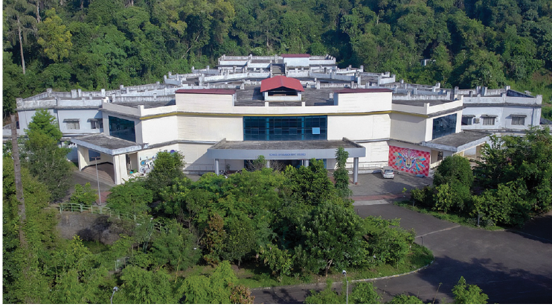
THANK YOU
https://nitc.ac.in/

